Slide 1
P.R.A.Y.
People Religion And You
Changing the world through positivity

Slide 2
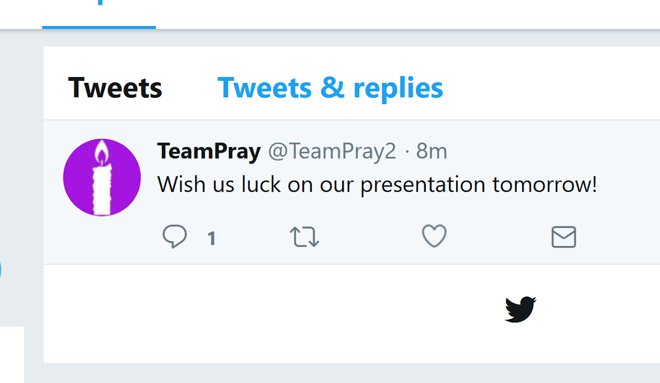
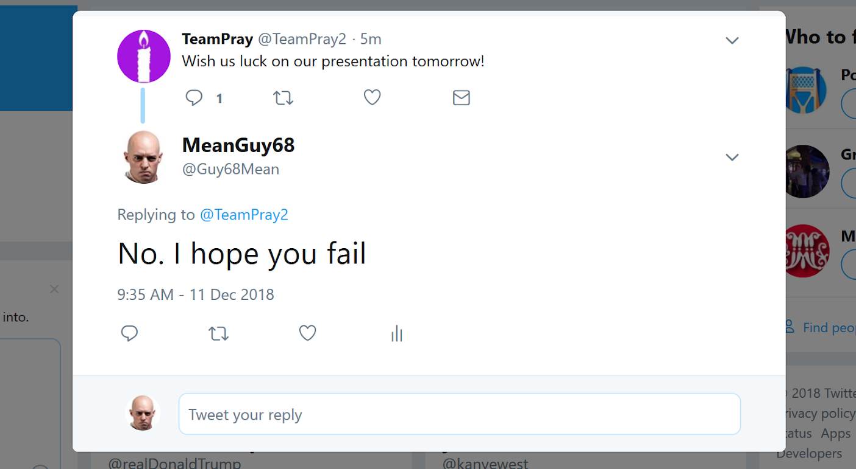
Yesterday I went on Social Media

Slide 3

The Solution
P.R.A.Y.

Slide 4
Who We Are
Riley E. Stadel -> Computer Science Concentration in Game Design
Daniel S. Schroeder -> Computer Science Concentration in Software Development
Ryan A. deMayo -> Computer Science Concentration in Software Development
Griffin H. Wiles -> Computer Science Concentration in Game Design
Christian Gorokhovsky -> Computer Science Concentration in Software Development

Slide 5
Why Choose P.R.A.Y.
Our Focus
Our Design
Ease of Expansion

Slide 6
Our Focus
We are the site that promotes positivity
Connecting people around the world with similar morals
Give users more control on what they see.
Weed out trolls by creating a “Community” feel

Slide 7
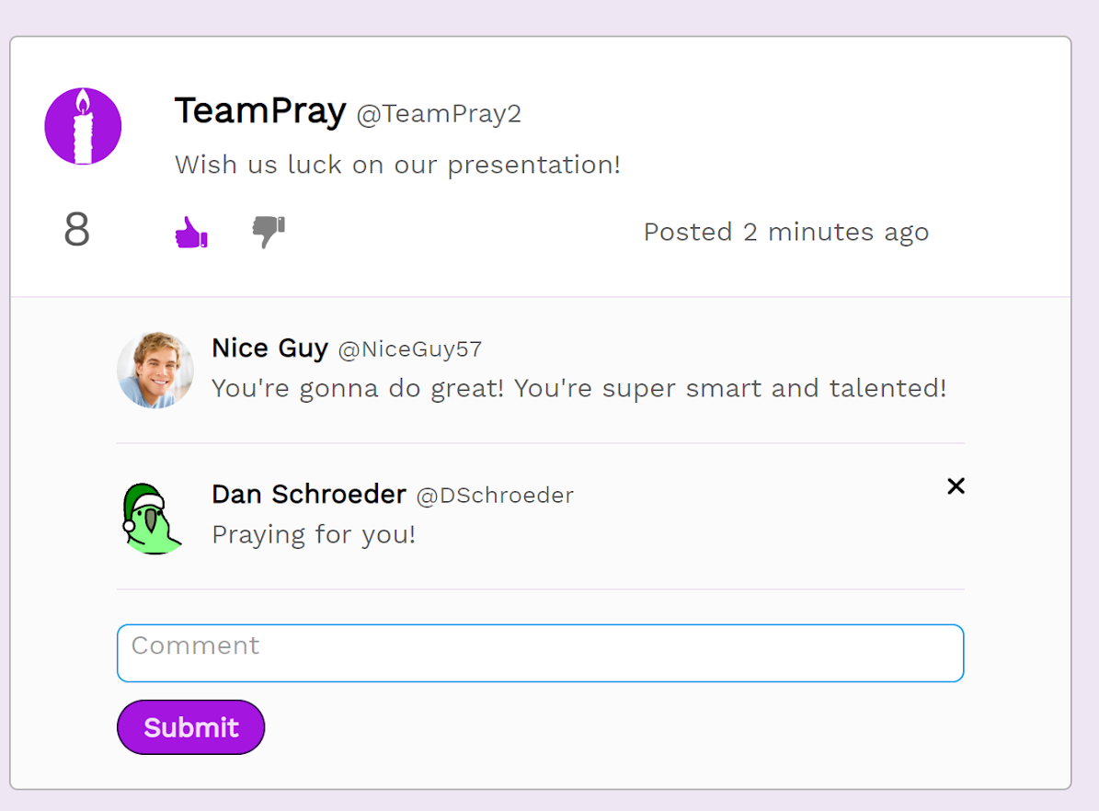
P.R.A.Y. Positivity

Slide 8
Our Design
Works on Desktop and Mobile
Abides by the 3 click rule
Very clean user interface

Slide 9
Ease of Expansion
All code and functions are original
Use of php class system to implement features
No external UI’s implemented
Allows for easier customization updates

Slide 10
What we’re asking
$50,000 for a 25% stake in P.R.A.Y.
$10,000 - CyberSecurity Assessment
$15,000 - Server Upgrades and Testing
$15,000 - Developer Charge
$10,000 - Advertising Fees
Notes:
Advertising fees
$5,000 -> Acquiring users
$5,000 -> Positive ads

Slide 11
Let’s Create Something Great Together
Social media network that promotes positivity
Clean design with easy flow
Design allows for easy implementations of expansion

Slide 12
Any Questions?

Slide 13
Demo
The site is currently live at Pray.rivas.ai

Slide 14
Thank you

